Slide 1
Software Analysis and Design (CS:3004)
Course Instructor: Nida Munawar
Email Address: nida.munawar@nu.edu.pk
Reference Book: Applying UML and Patterns (An introduction to Object-Oriented Analysis and Design And Iterative Development)
BY Craig Larman
Third Edition

Slide 2
Create a class in Java
class ClassName {
// fields
// methods
}

Slide 3
Create a class in Java
class Car {
// state or field
private int gear = 5;
// behavior or method
public void accelrator() {
System.out.println("Working of accelrator");
}
}

Slide 4
Java Objects
className object = new className();
// for Car class
Car suzuki = new Car();
Car toyota = new Car();

Slide 5
Basic Syntax
public class MyFirstJavaProgram {
public static void main(String []args) {
System.out.println("Hello World");
}
}

Slide 6
how to save the file, compile, and run the program.
Open notepad and add the code as above.
Save the file as: MyFirstJavaProgram.java.
Open a command prompt window and go to the directory where you saved the class. Assume it's C:\.
Type 'javac MyFirstJavaProgram.java' and press enter to compile your code. If there are no errors in your code, the command prompt will take you to the next line (Assumption : The path variable is set).
Now, type ' java MyFirstJavaProgram ' to run your program.
You will be able to see ' Hello World ' printed on the window.

Slide 7
Basic Syntax
Case Sensitivity − Java is case sensitive, which means identifier Hello and hello would have different meaning in Java.
Class Names − For all class names the first letter should be in Upper Case. If several words are used to form a name of the class, each inner word's first letter should be in Upper Case.
Example: class MyFirstJavaClass
Method Names − All method names should start with a Lower Case letter. If several words are used to form the name of the method, then each inner word's first letter should be in Upper Case.
Example: public void myMethodName()
Program File Name − Name of the program file should exactly match the class name.
When saving the file, you should save it using the class name (Remember Java is case sensitive) and append '.java' to the end of the name (if the file name and the class name do not match, your program will not compile).
Example: Assume 'MyFirstJavaProgram' is the class name. Then the file should be saved as 'MyFirstJavaProgram.java'
public static void main(String args[]) − Java program processing starts from the main() method which is a mandatory part of every Java program.

Slide 8
Object and Class Example: main within the class
class Student{
int id;
String name;
public static void main(String args[]){
Student s1=new Student();//creating an object of Student
//Printing values of the object
System.out.println(s1.id);//accessing member through reference variable
System.out.println(s1.name);
}
}

Slide 9
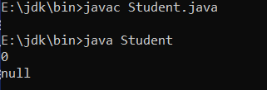
Output

Slide 10
Object and Class Example: main outside the class
//Creating Student.java class.
class Student{
int id;
String name;
}
//Creating another class TestStudent1.java which contains the main method
class TestStudent1{
public static void main(String args[]){
Student s1=new Student();
System.out.println(s1.id);
System.out.println(s1.name);
}
}

Slide 11













Classes
A class is a description of a set of objects that share the same attributes, operations, relationships, and semantics.
Graphically, a class is rendered as a rectangle, usually including its name, attributes, and operations in separate, designated compartments.
ClassName
attributes
operations

Slide 12




Class Names
ClassName
attributes
operations
The name of the class is the only required tag in the graphical representation of a class. It always appears in the top-most compartment.

Slide 13














Class Attributes
Person
name : String address : Address birthdate : Date ssn : Id
An attribute is a named property of a
class that describes the object being modeled.
In the class diagram, attributes appear in the second compartment just below the name-compartment.

Slide 14














Class Attributes (Cont’d)
Attributes are usually listed in the form:
attributeName : Type
A derived attribute is one that can be computed from other attributes, but doesn’t actually exist. For example,
a Person’s age can be computed from his birth date. A derived attribute is designated by a preceding ‘/’ as in:
/ age : Date
Person
name : String address : Address birthdate : Date / age : Date ssn : Id

Slide 15
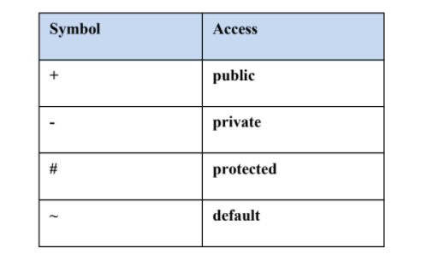
Access modifiers

Slide 16











Class Attributes (Cont’d)
Person
+ name : String # address : Address # birthdate : Date / age : Date - ssn : Id
Attributes can be:
+ public
# protected
- private
/ derived

Slide 17
Describing class and class attributes and constructor
public class Person {
private String name;
private int age;
public Person(String initialName) {
this.name = initialName;
this.age = 0;
}
}

Slide 18
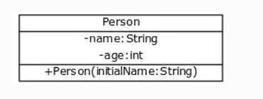

Slide 19
Describing class methods
public class Person {
private String name;
private int age;
public Person(String initialName) {
this.name = initialName;
this.age = 0;
}
public void printPerson() {
System.out.println(this.name + ", age " + this.age + " years");
}
public String getName() {
return this.name;
}
}

Slide 20
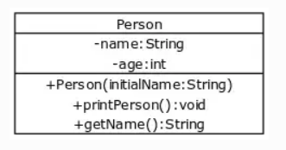

Slide 21







Class Operations
Person
name : String address : Address birthdate : Date ssn : Id
eat sleep work play
Operations describe the class behavior and appear in the third compartment.

Slide 22









Class Responsibilities
A class may also include its responsibilities in a class diagram.
A responsibility is a contract or obligation of a class to perform a particular service.
SmokeAlarm
Responsibilities -- sound alert and notify guard station when smoke is detected. -- indicate battery state

Slide 23
UML Class Diagrams Relationship:
There are following key relationships between classes in a UML class diagram:
1. Association
2. Generalization/ Inheritance
3. Realization/ Implementation
4. Dependency
5. Aggregation
6. Composition

Slide 24
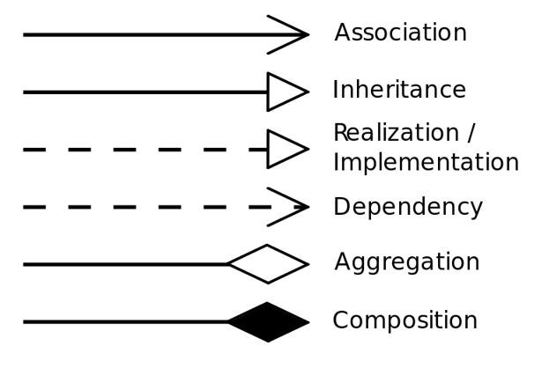

Slide 25


















Dependency Relationships
A dependency indicates a semantic relationship between two or
more elements. The dependency from CourseSchedule to Course exists because Course is used in both the add and remove operations of CourseSchedule.
CourseSchedule
Course
add(c : Course) remove(c : Course)

Slide 26
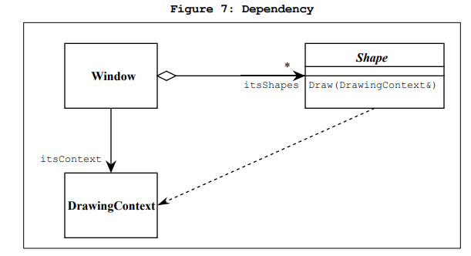
Dependency Relationships(‘using’ relationship)
Exists between two classes if changes to the definition of one may cause changes to the other (but not the other way around).

Slide 27








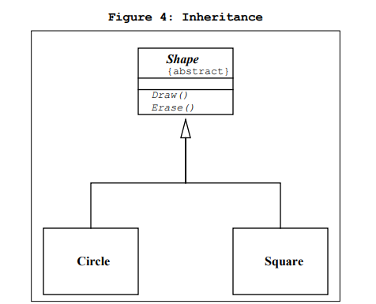

Generalization Relationships
Person
A generalization connects a subclass to its superclass. It denotes an inheritance of attributes and behavior
from the superclass to the subclass and indicates a specialization in the subclass of the more general superclass.
Student

Slide 28





Generalization Relationships
UML permits a class to inherit from multiple superclasses, although some programming languages (e.g., Java) do not permit multiple inheritance.
Student
Employee
TeachingAssistant

Slide 29




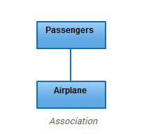
Association Relationships
If two classes in a model need to communicate with each other, there must be link between them.
An association denotes that link.
Student |  | Sports
Association is a broad term that encompasses just about any logical connection or relationship between classes.

Slide 30
Some objects are made up of other objects. Association specifies a "has-a" or "whole/part" relationship between two classes. In an association relationship, an object of the whole class has objects of part class as instance data.

Slide 31
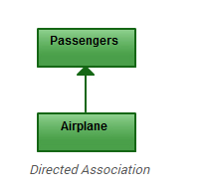
Directed Association(Unidirectional association)
In a unidirectional association, two classes are related, but only one class knows that the relationship exists.
A unidirectional association is drawn as a solid line with an open arrowhead pointing to the known class.

Slide 32

Bidirectional (standard) association
- An association is a linkage between two classes. Associations are always assumed to be bi-directional; this means that both classes are aware of each other and their relationship, unless you qualify the association as some other type.
A bi-directional association is indicated by a solid line between the two classes.

Slide 33
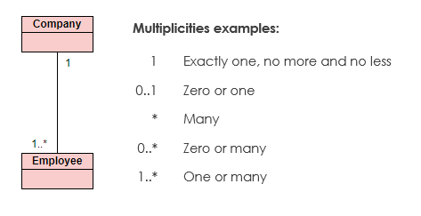
Multiplicity
Place multiplicity notations near the ends of an association. These symbols indicate the number of instances of one class linked to one instance of the other class. For example, one company will have one or more employees, but each employee works for one company only.

Slide 34

Association Relationships
We can indicate the multiplicity of an association by adding multiplicity adornments to the line denoting the association.
Student |  | Sports
 | 1..*

Slide 35
Association Relationships
Student |  | Sports
 | 1..*

Slide 36
Association Relationships
We can also indicate the behavior of an object in an association (i.e., the role
of an object)
Student |  | Sports
 | 1..* 1..*

Slide 37








Association Relationships
We can specify dual associations.
member of
Student |  | Team
 | ^{1..*} Consists of ^{1..*}
 | 1 president of 1..*

Slide 38










Association Relationships
Associations can also be objects themselves, called link classes or an
association classes.
Registration
modelNumber serialNumber warrentyCode
Product
Warranty

Slide 39
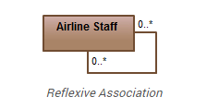
Reflexive Association
This occurs when a class may have multiple functions or responsibilities. For example, a staff member working in an airport may be a pilot, aviation engineer, a ticket dispatcher, a guard, or a maintenance crew member.

Slide 40









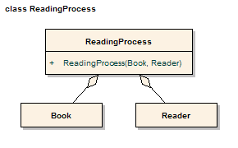
Association Relationships
We can model objects that contain other objects by way of special associations called aggregations and compositions.
An aggregation specifies a whole-part relationship between an aggregate (a whole) and a constituent part, where the part can exist independently from the aggregate. Aggregations are denoted by a hollow-diamond adornment on the association.

Slide 41
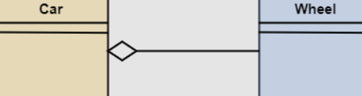
Aggregation
In aggregation, the contained classes are not strongly dependent on the lifecycle of the container.
Let us consider an example of a car and a wheel. A car needs a wheel to function correctly, but a wheel doesn’t always need a car. It can also be used with the bike, bicycle, or any other vehicles but not a particular car. Here, the wheel object is meaningful even without the car object. Such type of relationship is called an aggregation relation.

Slide 42
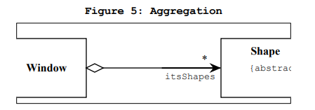
Aggregation in c++
class Window {
public:
//...
private:
vector itsShapes;
};

Slide 43
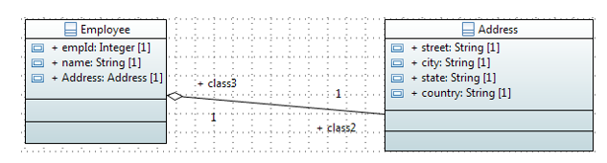
Aggregation in java

Slide 44
Address.java
public class Address { String city,state,country; public Address(String city, String state, String country) { this.city = city; this.state = state; this.country = country; } }

Slide 45
Employee.java
public class Employee { int id; String name; Address address; public Employee(int id, String name,Address address) { this.id = id; this.name = name; this.address=address; } }

Slide 46












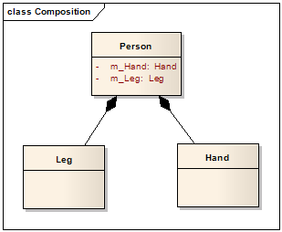
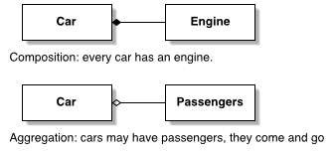
Association Relationships
A composition indicates a strong ownership and coincident lifetime of parts by the whole (i.e., they live and die as a whole). Compositions are denoted by a filled-diamond adornment on the association.
It is not a standard UML relationship,
Window
Scrollbar
1
1
Titlebar
1
1
Menu
1
1 ..
*

Slide 47
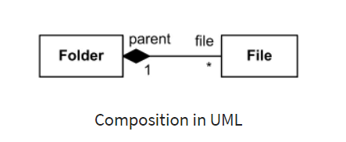
Composition
When an object contains the other object, if the contained object cannot exist without the existence of container object, then it is called composition.

Slide 48
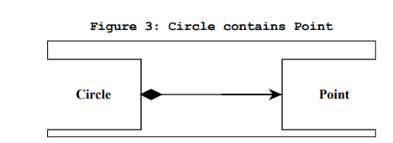
Composition in c++
In this case we have represented the composition relationship as a member variable. We could also have used a pointer so long as the destructor of Circle deleted the pointer
class Circle {
public:
void SetCenter(const Point&);
void SetRadius(double);
double Area() const;
double Circumference() const;
private:
double itsRadius;
Point itsCenter;
};

Slide 49
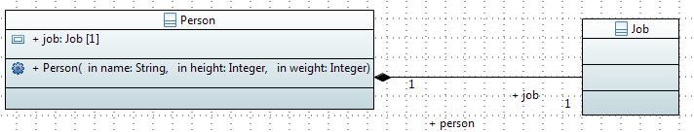
Composition in java

Slide 50
Job.java
public class Job { private long salary; public long getSalary() { return salary; } public void setSalary(long salary) { this.salary = salary; } }

Slide 51
Person.java
public class Person { //composition has-a relationship private Job job; public Person(){ this.job=new Job(); job.setSalary(1000L); } public long getSalary() { return job.getSalary(); } }

Slide 52
Main .java
public class TestPerson { public static void main(String[] args) { Person person = new Person(); long salary = person.getSalary(); } }

Slide 53
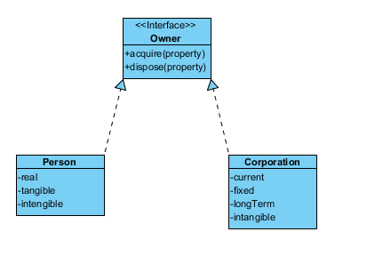
Realization relation(interface)
A realization is a relationship between two things where one thing (an interface) specifies a contract that another thing (a class) guarantees to carry out by implementing the operations specified in that contract.
In a class diagram, realization relationship is rendered as a dashed directed line with an open arrowhead pointing to the interface.
For example, the Owner interface might specify methods for acquiring property and disposing of property. The Person and Corporation classes need to implement these methods, possibly in very different ways.

Slide 54













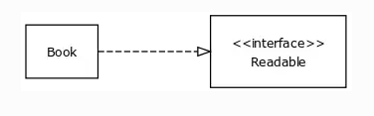
Interfaces
An interface is a named set of operations that specifies the behavior of objects without showing their inner structure. It can be rendered in the model by a one- or two- compartment rectangle, with the stereotype
<<interface>> above the interface name.
<<interface>> ControlPanel
Book implements interface Readable

Slide 55









Interface Services
<<interface>>
ControlPanel
Interfaces do not get instantiated. They have no attributes or state. Rather, they specify the services offered by a related class.
getChoices : Choice[] makeChoice (c : Choice) getSelection : Selection

Slide 56
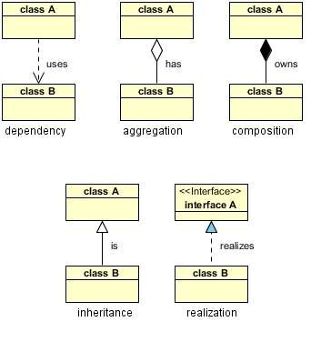
Relationships in Nutshell
Dependency : class A uses class B
Aggregation : class A has a class B
Composition : class A owns a class B
Inheritance : class B is a Class A (or class A is extended by class B)
Realization : class B realizes Class A (or class A is realized by class B)

Slide 57
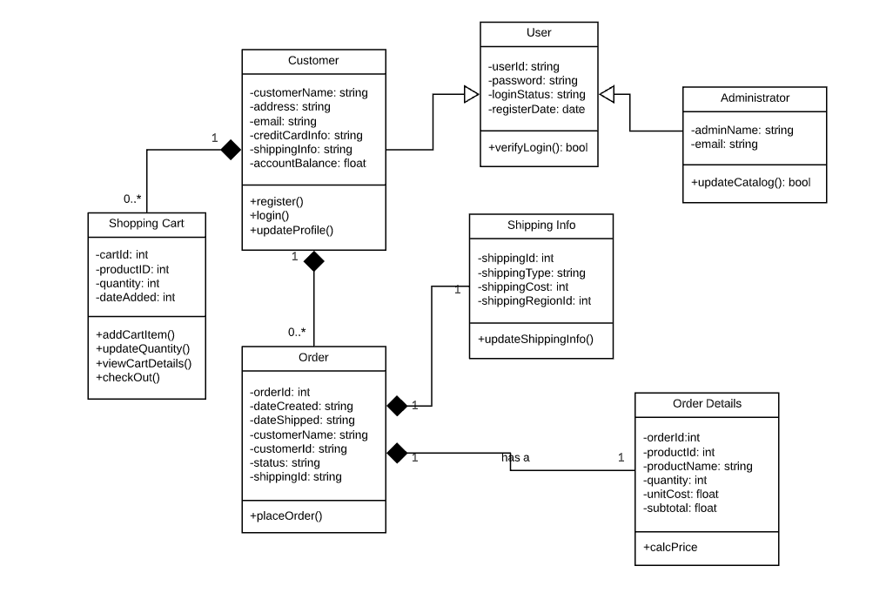
Identify the relationship

Slide 58
Dependency
 Dependency is represented when a reference to one class is passed in as a method parameter to another class. For example, an instance of class B is passed in to a method of class A:
1public class A {
2
3 public void doSomething(B b) {

Slide 59
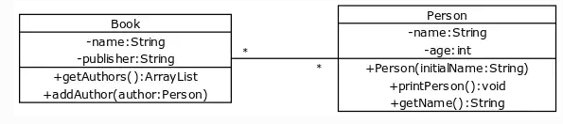
Association
public class Book {
private String name;
private String publisher;
private ArrayList<Person> authors;
// ..
}
import java.util.ArrayList;
public class Person {
private String name;
private int age;
private ArrayList<Book> books;
// ...
}

Slide 60
Aggregation
 Now, if class A stored the reference to class B for later use we would have a different relationship called Aggregation. A more common and more obvious example of Aggregation would be via setter injection:
1public class A { 2
3
4
5
private B _b;
public void setB(B b) { _b = b; }

Slide 61
Composition
 Aggregation is the weaker form of object containment (one object contains other objects). The stronger form is called Composition. In Composition the containing object is responsible for the creation and life cycle of the contained object (either directly or indirectly). Following are a few examples of Composition. First, via member initialization:
1public class A { 2
1public class A { 2
3 private B _b = new B();
3
4
5
6
7
private B _b;
public A() {
_b = new B();
} // default constructor

Slide 62
Inheritance
1public class A { 2
3 ...
4
5} // class A 6
7public class B extends A { 8
9 ....
10
11} // class B

Slide 63
Realization
1public interface A { 2
3 ...
4
5} // interface A 6
7public class B implements A { 8
9 ...
10
11} // class B

Slide 64












Parameterized Class
A parameterized class or template
defines a family of potential elements.
To use it, the parameter must be bound.
T
LinkedList
T
1 .. *
A template is rendered by a small dashed rectangle superimposed on the upper-right corner of the class rectangle. The dashed rectangle contains a list of formal parameters for the class.

Slide 65
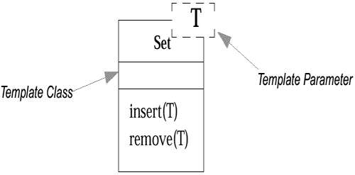







Example : Parameterized Class
class Set <T> {
void insert (T newElement);
void remove (T anElement);
}
Set <Employee> employeeSet;

Slide 66
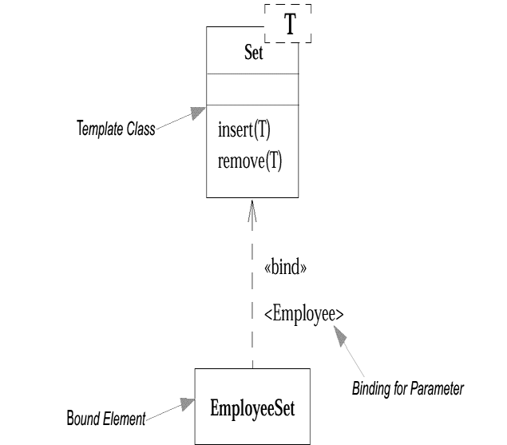
A use of a parameterized class, such as Set<Employee>, is called a bound element.

Slide 67







Parameterized Class (Cont’d)
Some object-oriented languages such as C++ and Ada support the concept of parametrized classes.
They are most commonly used for the element type of collection classes, such as the elements of lists.
For example, in Java, suppose that a Board software object holds a List of many Squares. And, the concrete class that implements the List interface is
an ArrayList:
public class Board
{
private List<Square> squares = new ArrayList<Square>();
// …
}

Slide 68



Parameterized Class (Cont’d)
T
Binding is done with the <<bind>> stereotype and a parameter to supply to the template. These are adornments to the dashed arrow denoting the realization relationship.
Here we create a linked-list of names for
the Students List.
LinkedList
T
1..*
<<bind>>(Name)
StudentList

Slide 69




Enumeration
An enumeration is a user-defined data type that consists of a name and an ordered list of enumeration literals.
<<enumeration>> Boolean
false true

Slide 70














Exceptions
<<exception>>
Exception
Exceptions can be modeled just like any other class.
Notice the <<exception>> stereotype in the name compartment.
getMessage() printStackTrace()
<<exception>>
InterfaceException
<<exception>>
SQLException

